Slide 1
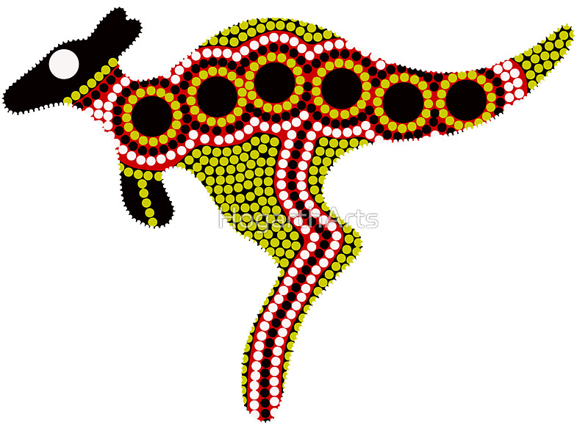
Resources needed:
finger paint
or
cocktail sticks and paint
or
felt tips
or
crayons

Slide 2
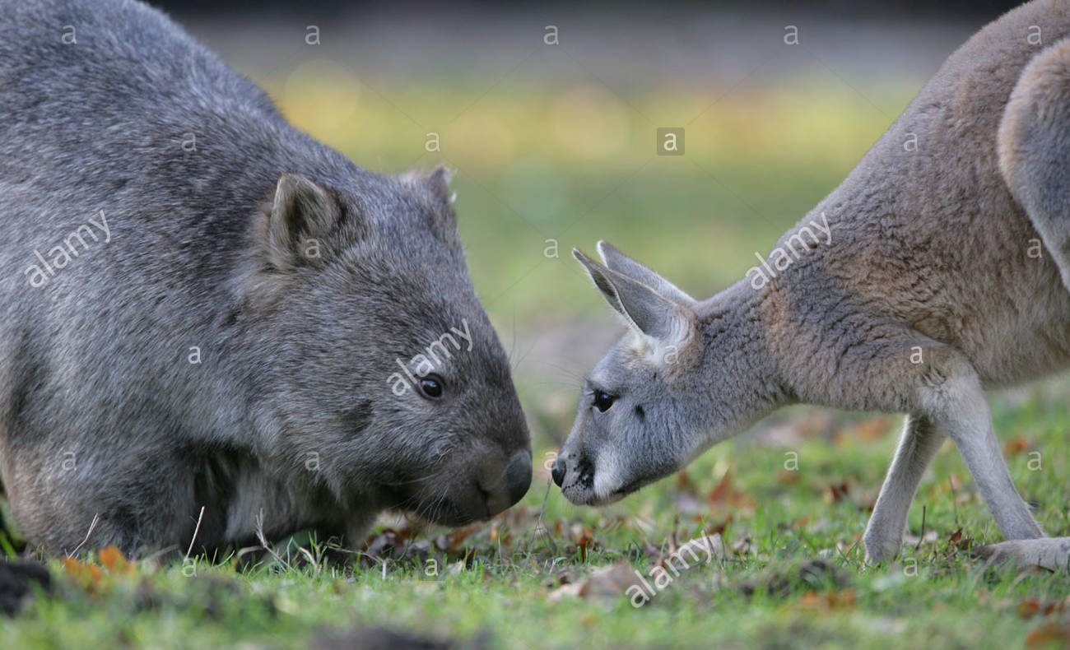

Slide 3
“DREAMTIME”
LET’S PAINT:
Watch a video about an aboriginal story:
Open the link below
Success Criteria | Code / comment
Know what dreamtime is.
Observe video of wombat and kangaroo
Understand wombat and kangaroo’s feelings
Identify happy / sad / angry
Is able to create a picture using aboriginal tools and colours.
Uses correct tools.
Uses correct colours.
Follows the order of sequence.
http://www.youtube.com/watch?v=xDJrnldb08o
what is a wombat

Slide 4
Kangaroo template to copy

Slide 5
Kangaroo template to copy

